Slide 1

Data Science Training Program
Data Science Training Program
Presented by: Tanmay Yadav
Guided by: Ranjit Sir
This presentation outlines the comprehensive Data Science course I undertook, guided by the expertise of Ranjit Sir. Throughout the course, we explored various aspects of data science, from foundational concepts to advanced techniques in data analytics, machine learning, and artificial intelligence. This PPT encapsulates the key learnings, projects, and tools we covered, showcasing the practical skills and knowledge I gained during the training. It serves as a summary of my journey through the course and the expertise I developed along the way.

Slide 2
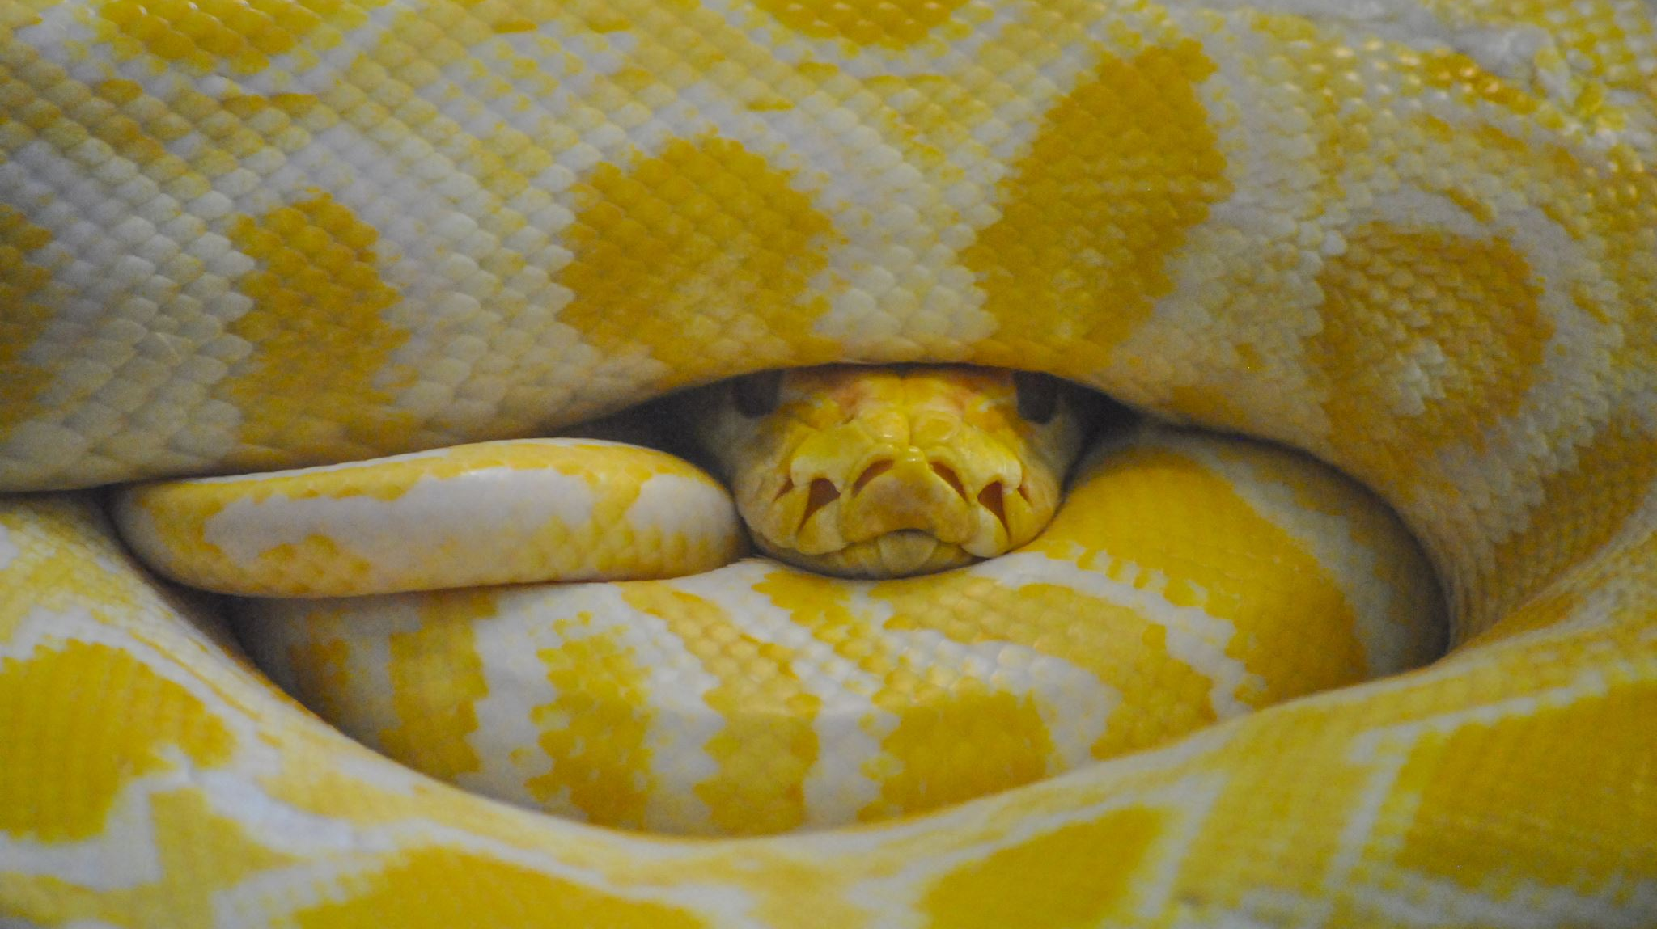
Setting Up Python
Title: Setting Up Python

Slide 3

Install Python
Install Python:
Visit python.org and download the latest version.
Ensure that you add Python to the PATH during installation.
Install an IDE:
Recommended IDEs: PyCharm, VSCode, Jupyter Notebook.
Verify Installation:
Open a terminal or command prompt and type python --version.
Install essential packages: pip install numpy pandas matplotlib.

Slide 4
Basic Python Commands
Print Statement:
Basic Python Commands
Print Statement:
Syntax: print("Hello, World!")
Variables:
Assign values: x = 10
Print variable: print(x)
Basic Arithmetic:
Addition: a + b
Subtraction: a - b
Multiplication: a * b
Division: a / b

Slide 5

Python Data Structures - Lists

Slide 6

Definition
Definition:
A list is an ordered collection of items.
Example: my_list = [1, 2, 3, 4, 5]
Insert:
Add an item: my_list.append(6)
Insert at position: my_list.insert(2, 10)
Remove:
Remove an item: my_list.remove(10)
Remove by index: my_list.pop(2)

Slide 7
Python Data Structures - Tuples

Slide 8

Definition
Title: Python Data Structures - Tuples
Definition:
A tuple is an ordered, immutable collection of items.
Example: my_tuple = (1, 2, 3, 4, 5)
Accessing Elements:
Access by index: my_tuple[1]
Slicing: my_tuple[1:3]

Slide 9
Python Data Structures - Dictionaries

Slide 10

Definition
A dictionary is an unordered collection of key-value pairs.
Example: my_dict = {'name': 'John', 'age': 25}
Accessing Values:
Access by key: my_dict['name']
Adding a new key-value pair: my_dict['city'] = 'New York'
Removing Items:
Remove by key: my_dict.pop('age')

Slide 11

Python Data Structures - Sets

Slide 12
Definition
A set is an unordered collection of unique items.
Example: my_set = {1, 2, 3, 4, 5}
Add and Remove:
Add an item: my_set.add(6)
Remove an item: my_set.remove(3)
Set Operations:
Union: set1.union(set2)
Intersection: set1.intersection(set2)

Slide 13
Python Data Types
Common Data Types:
int (Integer): x = 5
float (Floating-point): y = 3.14
str (String): z = "Hello"
bool (Boolean): a = True
Type Conversion:
Convert between types: int("5"), str(10), float(3)

Slide 14

Python Operators
Title: Python Operators

Slide 15
Arithmetic Operators:
Addition: +
Subtraction: -
Multiplication: *
Division: /
Assignment Operators:
x += 5 (equivalent to x = x + 5)
x *= 2 (equivalent to x = x * 2)
Comparison Operators:
Equal: ==
Not equal: !=
Greater than: >
Less than: <

Slide 16

Python Conditional Statements
If-Else:
Syntax:
if condition: # code to execute if condition is true else: # code to execute if condition is false
Example:
if x > 0: print("Positive") else: print("Negative or Zero")
Elif:
Syntax:
if condition1: # code elif condition2: # code else: # code

Slide 17
Python Logical and Membership Operators

Slide 18

Logical Operators
and, or, not
Example:
if x > 0 and y > 0: print("Both are positive")

Slide 19

Membership Operators
in, not in
Example:
if 'a' in 'apple': print("'a' is in the word 'apple'")

Slide 20
Python Loops

Slide 21
For Loop:
Syntax:
for item in iterable: # code
Example:
for i in range(5): print(i)
While Loop:
Syntax:
while condition: # code
Example:
while x > 0: print(x) x -= 1

Slide 22

Break, Continue, and Loop

Slide 23
Break Statement
Break Statement:
Exits the loop prematurely.
Example:
for i in range(10): if i == 5: break print(i)

Slide 24
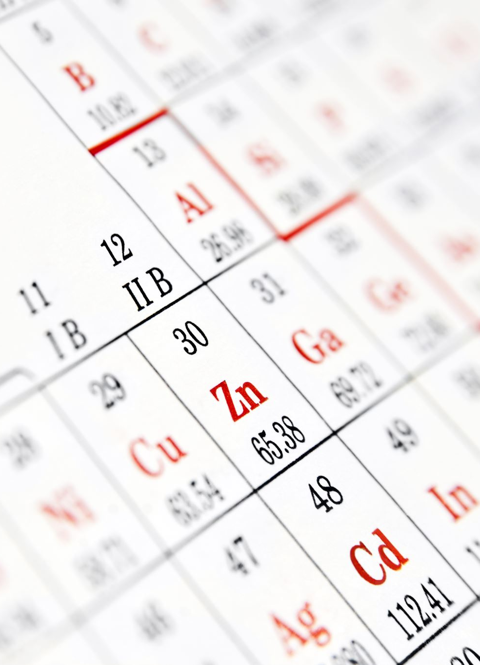
Continue Statement
Skips the current iteration and continues with the next.
Example:
for i in range(10): if i == 5: continue print(i)
Difference Between For and While Loop:
For Loop: Used when the number of iterations is known.
While Loop: Used when the number of iterations is not known.

Slide 25
Python Functions

Slide 26

Definition
Definition:
A function is a block of reusable code that performs a specific task.
Syntax:
Defining a function:
def function_name(parameters): # code return value
Example:
def add(x, y): return x +

Slide 27
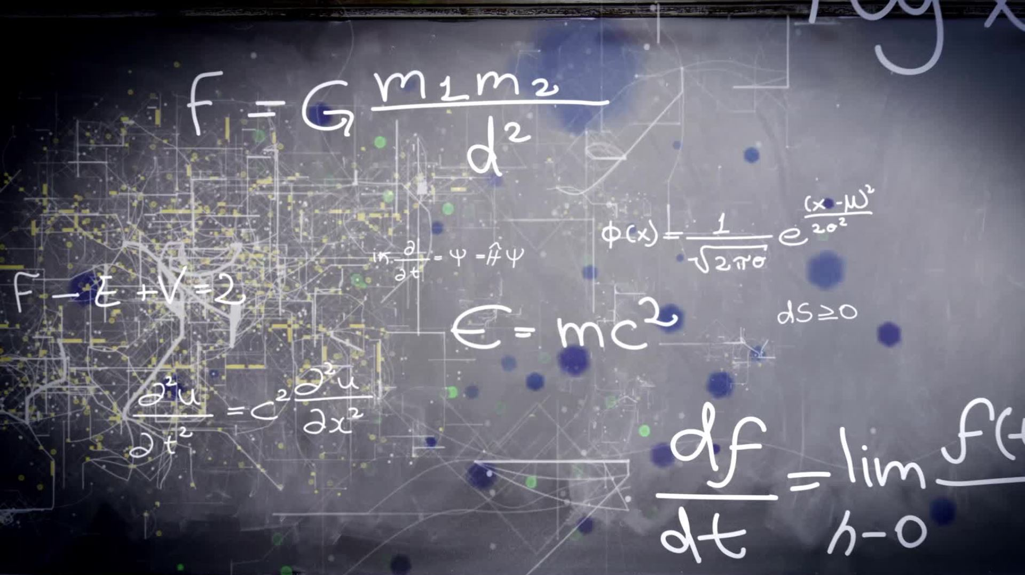
Types of Functions

Slide 28
Built-in Functions:
Examples: print(), len(), max(), min()
User-Defined Functions:
Functions created by the user to perform specific tasks.
Example:
def greet(name): return "Hello, " + name
Lambda Functions:
Small anonymous functions defined with lambda keyword.
Syntax:
lambda arguments: expression
Example:
add = lambda x, y: x + y

Slide 29
Python Modules and Exception Handling

Slide 30
Modules
Definition: A module is a file containing Python definitions and statements.
Importing Modules: Use import keyword.
Example:
import math print(math.sqrt(16))

Slide 31
Exception Handling
Exception Handling:
Definition: Mechanism to handle runtime errors.
Try-Except Block:
try: # code that might throw an exception except SomeException: # code to handle the exception
Example:
try: result = 10 / 0 except ZeroDivisionError: print("Cannot divide by zero")

Slide 32
Python OOP

Slide 33

Classes and Objects
Classes and Objects:
Class: Blueprint for creating objects.
Object: Instance of a class.
Example:
class Car: def __init__(self, make, model): self.make = make self.model = model

Slide 34
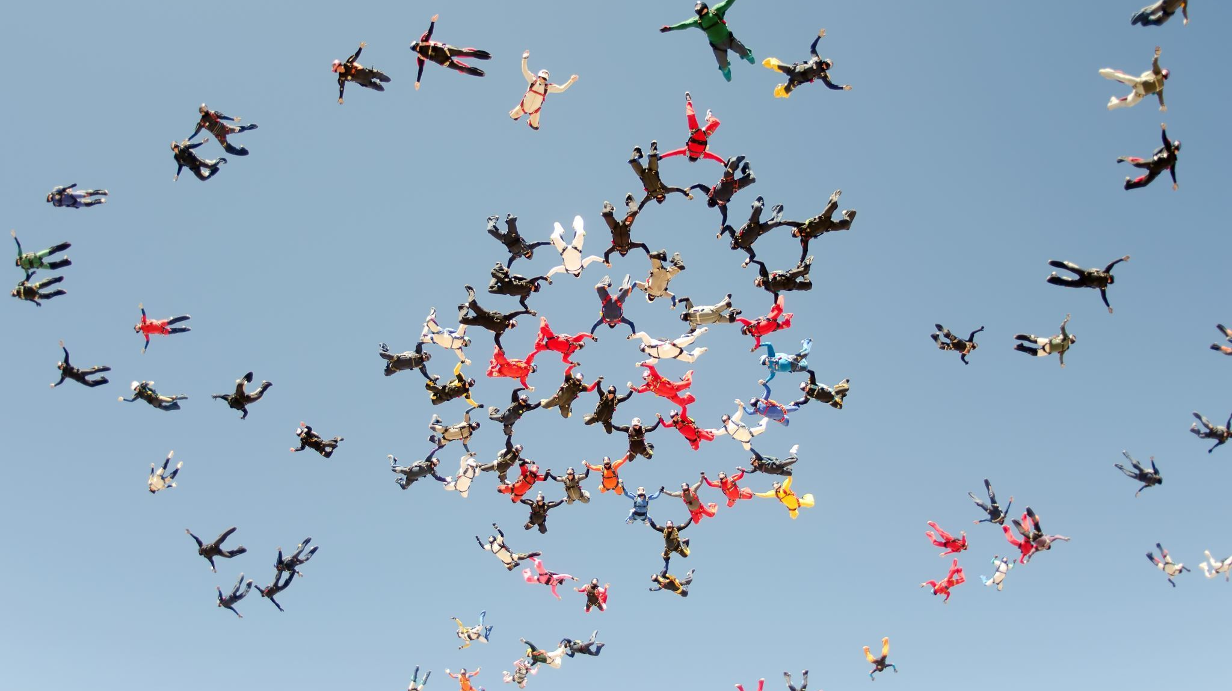
Inheritance
Inheritance:
Definition: A way to form new classes using classes that have already been defined.
Example:
class ElectricCar(Car): def __init__(self, make, model, battery_size): super().__init__(make, model) self.battery_size = battery_size

Slide 35

Introduction to Machine Learning

Slide 36

Definition
Definition:
Machine Learning (ML) is a subset of artificial intelligence (AI) that involves the development of algorithms that allow computers to learn from and make decisions based on data.
Applications:
Image recognition, natural language processing, fraud detection, recommendation systems, etc.

Slide 37

Types of Machine Learning Models

Slide 38

Supervised Learning
Definition: Models are trained on labeled data, meaning the input data is paired with the correct output.
Examples:
Regression: Predicting numerical values, e.g., house prices.
Classification: Categorizing data, e.g., spam detection.

Slide 39

Unsupervised Learning
Definition: Models find patterns or relationships in data without predefined labels.
Examples:
Clustering: Grouping data into clusters, e.g., customer segmentation.
Dimensionality Reduction: Simplifying data without losing important information, e.g., PCA.

Slide 40

Reinforcement Learning
Definition: Models learn by interacting with an environment and receiving feedback through rewards or penalties

Slide 41

Examples
Game AI, robotics, autonomous vehicles

Slide 42

Machine Learning Workflow
Data Collection: Gathering data from various sources
Data Preprocessing: Cleaning and preparing data for analysis
Feature Engineering: Selecting and transforming variables to improve model performance
Model Selection: Choosing the appropriate algorithm based on the problem type
Training: Feeding data into the model and adjusting parameters to minimize error
Evaluation: Testing the model's performance on unseen data
Deployment: Integrating the model into a production environment

Slide 43

Introduction to Deep Learning

Slide 44

Definition
Deep Learning is a subset of machine learning that uses neural networks with many layers to model complex patterns in data

Slide 45

Applications
Computer vision, natural language processing, speech recognition, and more

Slide 46
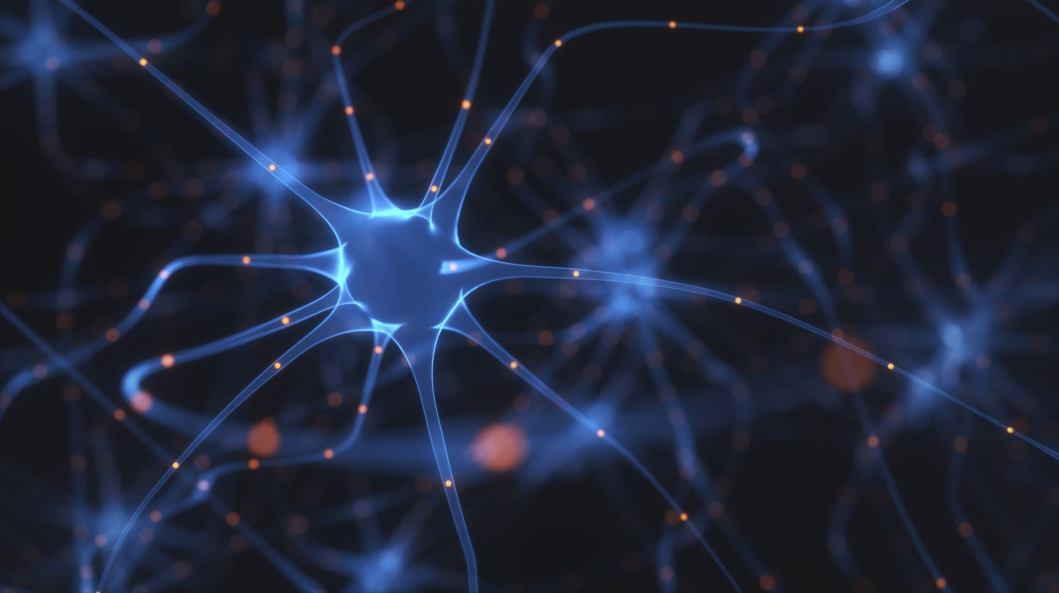
Artificial Neural Networks

Slide 47

Structure
Input Layer: Takes in the features from the dataset
Hidden Layers: Intermediate layers that process the input data using weights and biases
Output Layer: Produces the final prediction or classification

Slide 48

Activation Functions
ReLU : Most common, helps models learn non-linear patterns
Sigmoid: Used for binary classification
Softmax: Used for multi-class classification

Slide 49
Convolutional Neural Networks

Slide 50

Overview
Purpose: Specialized for processing grid-like data, such as images

Slide 51

Components
Convolutional Layers: Apply filters to the input to extract features
Pooling Layers: Reduce the dimensionality of the data, making the computation more efficient
Fully Connected Layers: Final layers that produce the classification or output
Applications:
Image classification, object detection, facial recognition.

Slide 52
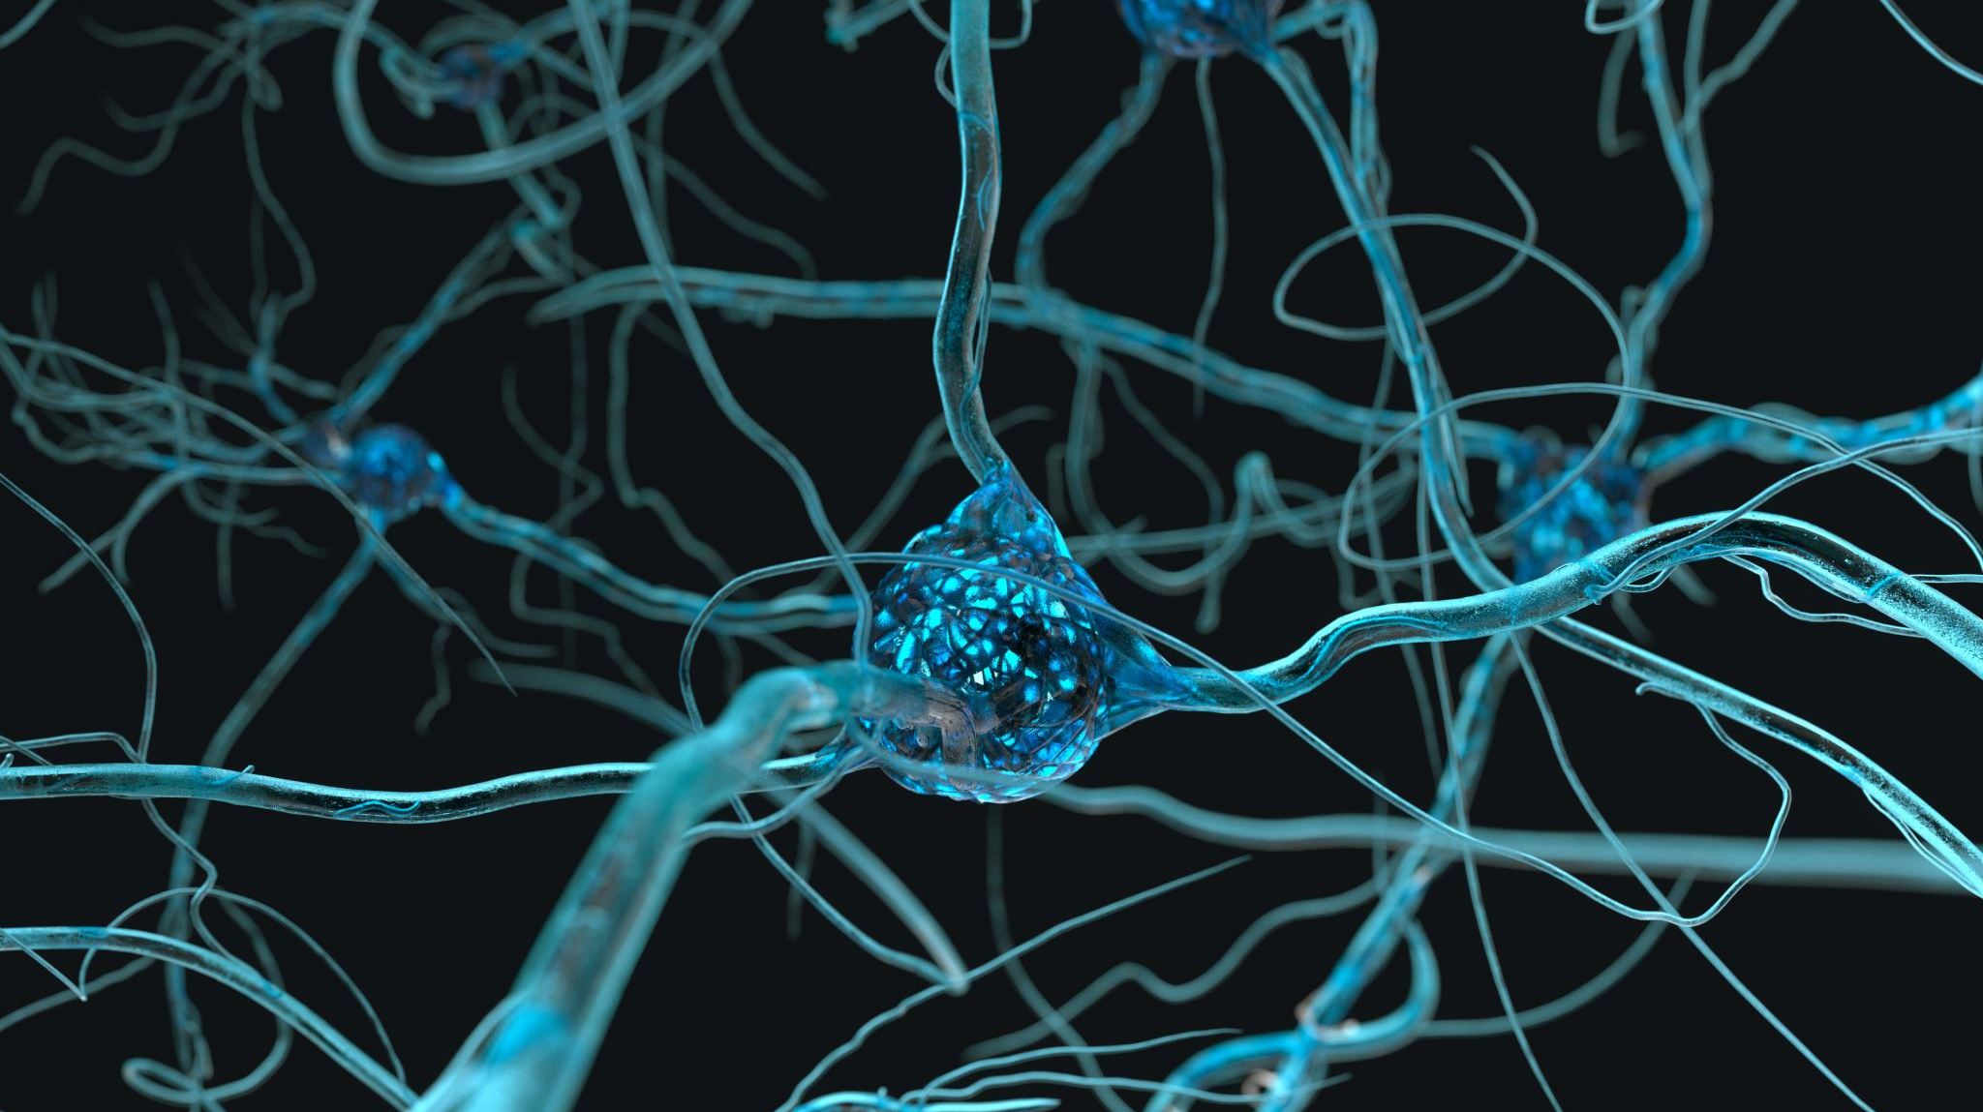
Recurrent Neural Networks

Slide 53
Overview
Purpose: Designed for sequential data, such as time series or natural language

Slide 54

Components
Recurrent Layers: Maintain a memory of previous inputs to inform current outputs
LSTM/GRU: Specialized RNN cells that solve the problem of long-term dependencies

Slide 55

Applications
Time series prediction, language modeling, machine translation

Slide 56

Large Language Models

Slide 57
Definition
LLMs are deep learning models trained on massive amounts of text data to generate or understand human language

Slide 58

Examples
GPT : Used for text generation
BERT : Used for understanding the context in text

Slide 59

Applications Chatbots, content creation, language translation, sentiment analysis.
GITHUB:DATA-SCIENCE-WITH-GENERATIVE-AI-AND-PROMPT-ENGINEERING/chatbot at main · Tanmay-yadav/DATA-SCIENCE-WITH-GENERATIVE-AI-AND-PROMPT-ENGINEERING

Slide 60
Python Assignments
Title: Python Assignments
Making Pyramids or Triangles Using For Loop:
Objective: Practice using loops to create patterns with stars (*) or numbers.
Example Code:
for i in range(1, 6): print("*" * i)
GitHub Link Option:
Included the link to the GitHub repository where this assignment can be submitted or reviewed.
Github: DATA-SCIENCE-WITH-GENERATIVE-AI-AND-PROMPT-ENGINEERING/python/assingment1.py at main · Tanmay-yadav/DATA-SCIENCE-WITH-GENERATIVE-AI-AND-PROMPT-ENGINEERING (github.com)

Slide 61

Python Assignments Continued
Title: Python Assignments
Finding Min, Average, Even Average, Odd Average, Max:
Objective: Learn to calculate statistical measures using Python lists.
Example Code:
numbers = [1, 2, 3, 4, 5] print("Min:", min(numbers)) print("Max:", max(numbers)) print("Average:", sum(numbers)/len(numbers))
GitHub Link: DATA-SCIENCE-WITH-GENERATIVE-AI-AND-PROMPT-ENGINEERING/python/assingment4.py at main · Tanmay-yadav/DATA-SCIENCE-WITH-GENERATIVE-AI-AND-PROMPT-ENGINEERING (github.com)

Slide 62
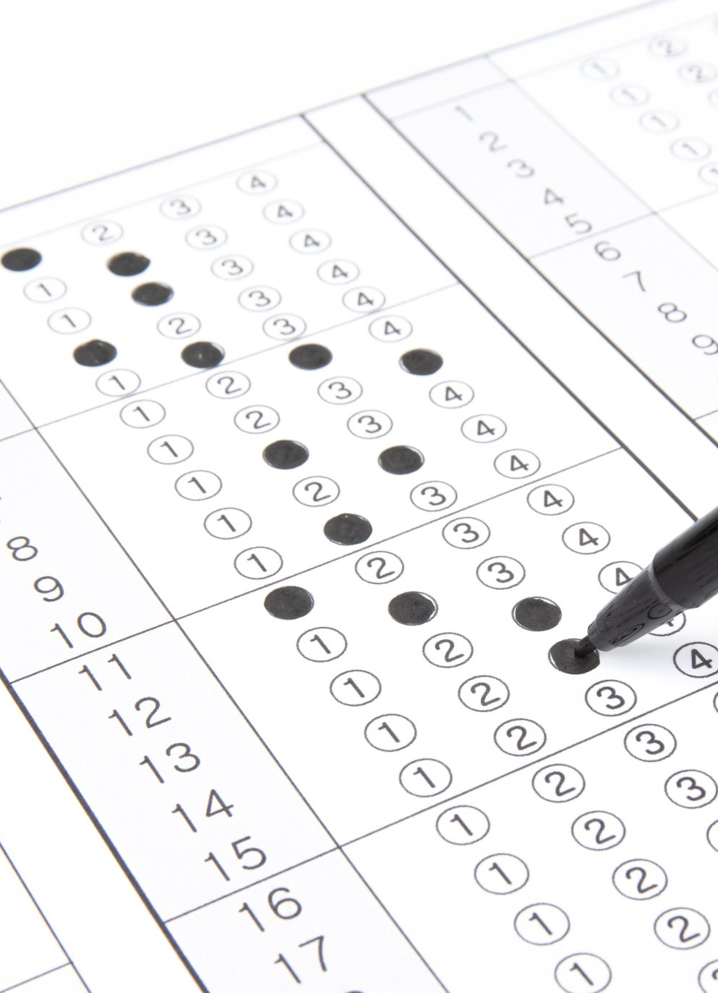
Advanced Python Assignments
Assignment on Excel Sheet:
Objective: Practice data manipulation by reading and writing Excel files using pandas.
Example Code:
python
Copy code
import pandas as pd df = pd.read_excel('file.xlsx') df['New Column'] = df['Existing Column'] * 2 df.to_excel('new_file.xlsx', index=False)
GitHub Link :DATA-SCIENCE-WITH-GENERATIVE-AI-AND-PROMPT-ENGINEERING/python/assingment5.ipynb at main · Tanmay-yadav/DATA-SCIENCE-WITH-GENERATIVE-AI-AND-PROMPT-ENGINEERING (github.com)

Slide 63

ATM Simulation
Objective: Create a command-line interface for simulating ATM operations
Example Features: Balance check, withdrawal, deposit
GitHub Link: DATA-SCIENCE-WITH-GENERATIVE-AI-AND-PROMPT-ENGINEERING/python/atm.py at main · Tanmay-yadav/DATA-SCIENCE-WITH-GENERATIVE-AI-AND-PROMPT-ENGINEERING

Slide 64
Python Projects
Title: Python Projects
CLI Based Messaging System
Objective: Build a command-line interface for a messaging system using Flask and Python

Slide 65

GitHub Link
Included the link to the GitHub repository where this assignment can be submitted or reviewed
GitHub: DATA-SCIENCE-WITH-GENERATIVE-AI-AND-PROMPT-ENGINEERING/chat.py at main · Tanmay-yadav/DATA-SCIENCE-WITH-GENERATIVE-AI-AND-PROMPT-ENGINEERING

Slide 66

LinkedIn Link
Added a LinkedIn link to highlight this project
LinkedIn: https://www.linkedin.com/posts/tanmay-yadav-277698233_python-socketprogramming-networking-activity-7219382487330824194-CVnM?
utm_source=share&utm_medium=member_desktop

Slide 67
Python Projects Continued
Title: Python Projects
Web Development Project
Objective: Develop a web application using Flask

Slide 68
GitHub Link: DATA-SCIENCE-WITH-GENERATIVE-AI-AND-PROMPT-ENGINEERING/Web_Development at main · Tanmay-yadav/DATA-SCIENCE-WITH-GENERATIVE-AI-AND-PROMPT-ENGINEERING

Slide 69
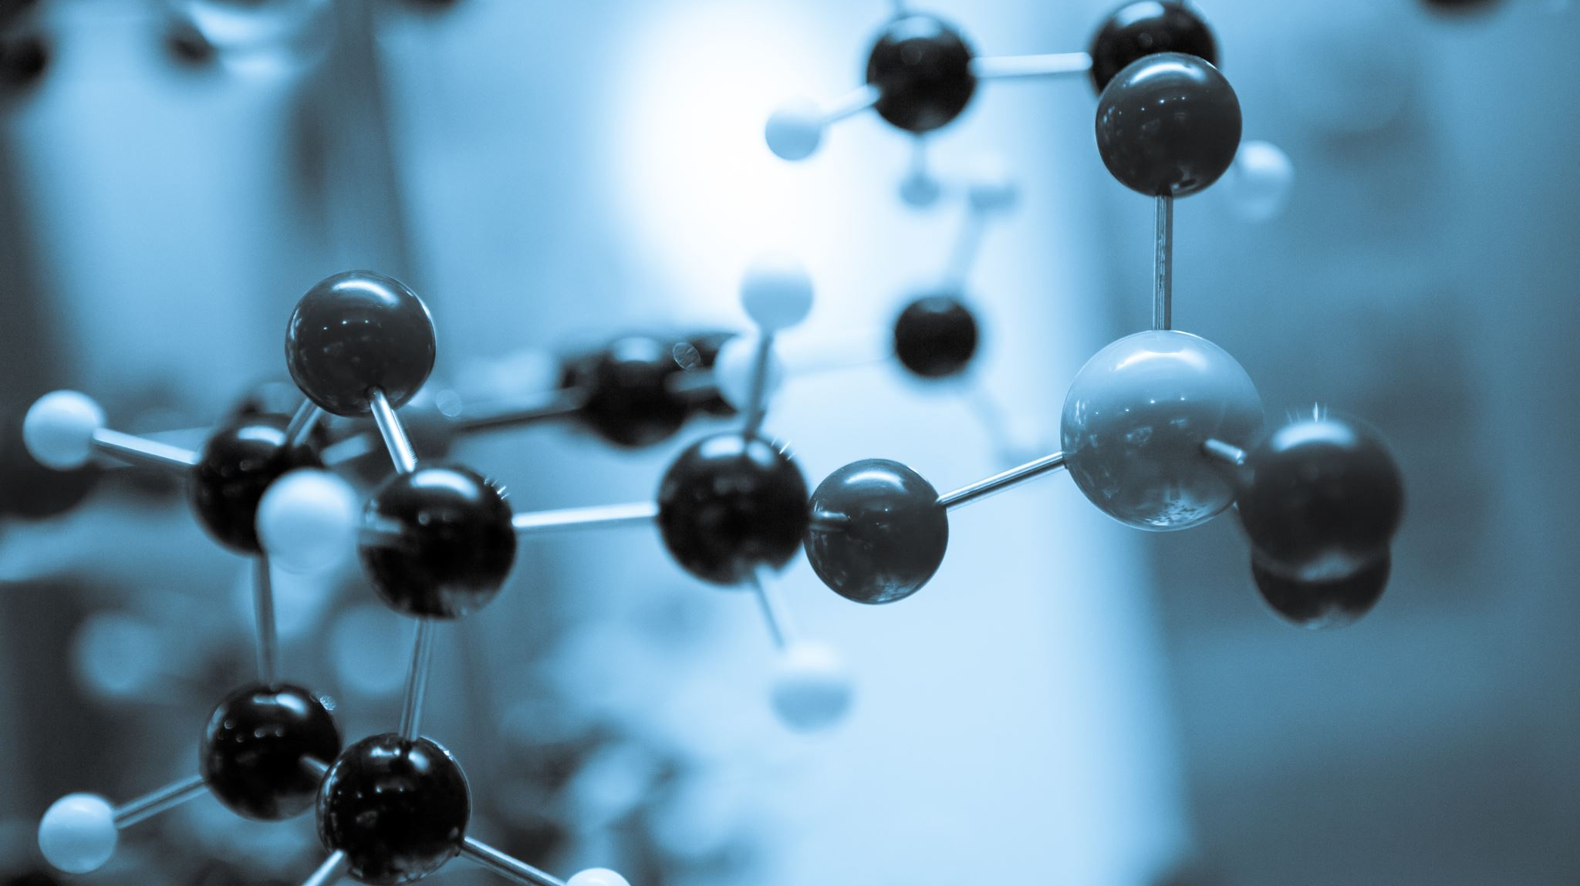
Data Science Projects

Slide 70
Customer Satisfaction Analysis
Objective: Analyze customer satisfaction data using numpy, pandas, matplotlib, and seaborn

Slide 71

Example Code
import numpy as npimport pandas as pdimport matplotlib.pyplot as pltimport seaborn as snsdf = pd.read_csv sns.heatmap , annot=True)plt.show

Slide 72
GitHub Link
Added the GitHub repository link for this project
GitHub:DataBase-project/customer_satisfaction at main · Tanmay-yadav/DataBase-project

Slide 73

LinkedIn Link
GitHub Link:
Added the GitHub repository link for this project.
GitHub:DataBase-project/customer_satisfaction at main · Tanmay-yadav/DataBase-project (github.com)
LinkedIn Link :
Added a LinkedIn link to feature this project.
LinkedIn: https: https://www.linkedin.com/posts/tanmay-yadav-277698233_datascience-customersatisfaction-machinelearning-activity-7227374464601055233-TABs?utm_source=share&utm_medium=member_desktop

Slide 74

Old Bike Price Prediction
Objective: Predict the prices of old bikes using a machine learning model
Details
Description: This project involves developing a model to estimate the price of used bikes based on various features such as brand, model, year, mileage, and other attributes
Features: The dataset includes information about bike attributes like brand, model, year of manufacture, mileage, and condition
Model: The project utilizes regression techniques to predict the price based on the input features
GitHub Link
DataBase-project/oldbikepricepredction at main · Tanmay-yadav/DataBase-project
LinkedIn Link: https://www.linkedin.com/posts/tanmay-yadav-277698233_datascience-machinelearning-bikepriceprediction-activity-7227365737214959617-Koee?

Slide 75

Machine Learning Projects Continued
Title: Machine Learning Projects
Spam Email Classification
Objective: Create a model to classify emails as spam or not spam using sklearn

Slide 76

Example Code
GitHub Link: DataBase-project/email_classification at main · Tanmay-yadav/DataBase-project
LinkedIn Link: https://www.linkedin.com/posts/tanmay-yadav-277698233_datascience-machinelearning-python-activity-7227778119829532672-WSK4?

Slide 77

Deep Learning Overview
Introduction to Deep Learning
Definition: Deep learning is a subset of machine learning that uses neural networks with many layers to model complex patterns in data
Key Concepts
Neural Networks: Composed of interconnected layers of neurons that process input data to make predictions or classify data
Activation Functions: Functions like ReLU, sigmoid, and tanh that introduce non-linearity into the model
Backpropagation: The process of adjusting the weights of the network by minimizing the loss function through gradient descent
Types of Neural Networks
Feedforward Neural Networks : Basic networks where connections do not form cycles
Convolutional Neural Networks : Specialized for processing grid-like data such as images

Slide 78

Deep Learning Overview
Introduction to Deep Learning
Recurrent Neural Networks : Designed for sequential data, such as time series or natural language
Applications
Image Recognition: Identifying objects within images using CNNs
Natural Language Processing: Understanding and generating human language with RNNs and Transformers
Recommendation Systems: Suggesting products based on user behavior and preferences
Chart
Deep Learning Model Architecture
A chart illustrating the typical architecture of a deep learning model, including input layers, hidden layers , and output layers
GitHub Link: DATA-SCIENCE-WITH-GENERATIVE-AI-AND-PROMPT-ENGINEERING/Deep Learning at main · Tanmay-yadav/DATA-SCIENCE-WITH-GENERATIVE-AI-AND-PROMPT-ENGINEERING

Slide 79
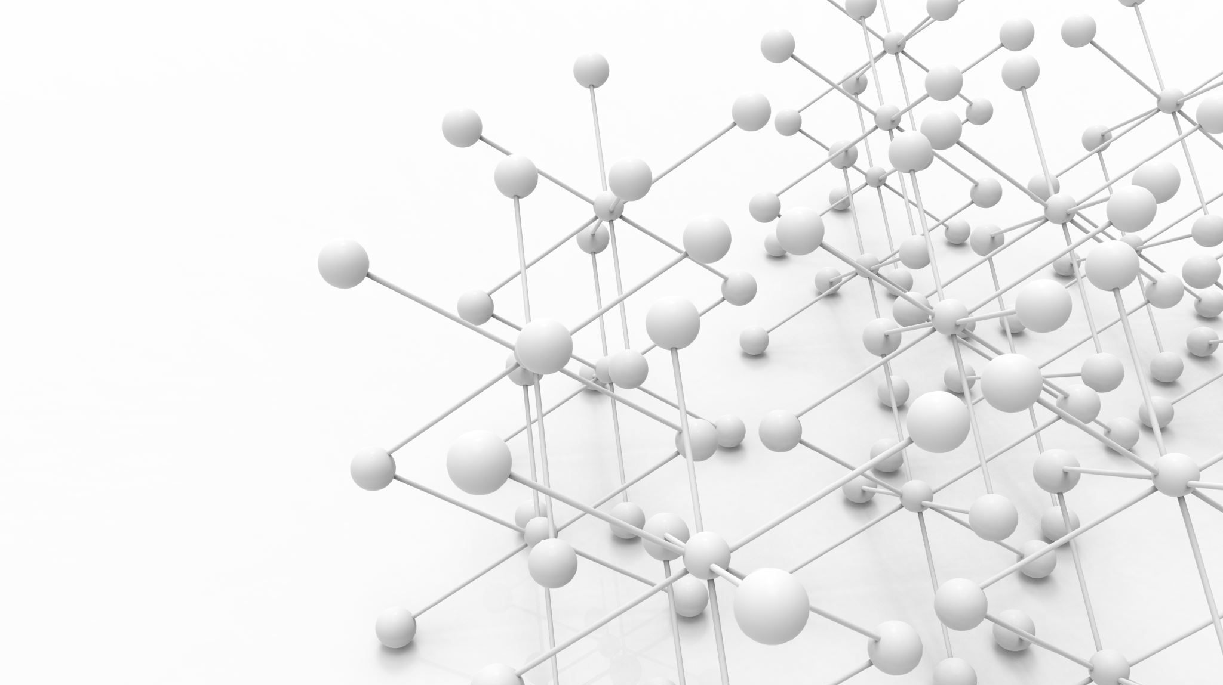
Artificial Neural Networks
Objective: Implement basic ANN models for various tasks

Slide 80
Artificial Neural Networks
Details
Structure
Input Layer: Receives the input features
Hidden Layers: Layers where computations are performed
Output Layer: Provides the final prediction or classification
Use Cases
Regression tasks
Classification problems
Training Process
Feed data through the network

Slide 81

Artificial Neural Networks
Details
Calculate loss using a loss function
Adjust weights using backpropagation and optimization algorithms
GitHub Link: DATA-SCIENCE-WITH-GENERATIVE-AI-AND-PROMPT-ENGINEERING/Deep Learning/ANN at main · Tanmay-yadav/DATA-SCIENCE-WITH-GENERATIVE-AI-AND-PROMPT-ENGINEERING

Slide 82

Convolutional Neural Networks
Objective: Build CNN models for tasks involving image data

Slide 83
Convolutional Neural Networks
Details
Layers
Convolutional Layers: Extract features from images
Pooling Layers: Reduce the dimensionality of feature maps
Fully Connected Layers: Perform classification based on extracted features
Applications
Image and video recognition
Image classification
Object detection
Training Process

Slide 84
Convolutional Neural Networks
Details
Apply convolutional filters to the input data
Use pooling to down-sample feature maps
Flatten and pass through fully connected layers to make predictions
GitHub Link: DATA-SCIENCE-WITH-GENERATIVE-AI-AND-PROMPT-ENGINEERING/Deep Learning/CNN at main · Tanmay-yadav/DATA-SCIENCE-WITH-GENERATIVE-AI-AND-PROMPT-ENGINEERING

Slide 85
Recurrent Neural Networks
Objective: Develop RNN models for sequential data tasks

Slide 86

Recurrent Neural Networks
Details
Structure
Recurrent Layers: Maintain state across sequences
LSTM/GRU Cells: Advanced RNN units to handle long-term dependencies and prevent vanishing gradients
Applications
Time series forecasting
Natural language processing
Training Process
Feed sequences into the network
Maintain memory through recurrent connections

Slide 87

Recurrent Neural Networks
Details
Use LSTM or GRU units to handle complex dependencies
GitHub Link: DATA-SCIENCE-WITH-GENERATIVE-AI-AND-PROMPT-ENGINEERING/Deep Learning/RNN at main · Tanmay-yadav/DATA-SCIENCE-WITH-GENERATIVE-AI-AND-PROMPT-ENGINEERING

Slide 88
CHATBOT
A chatbot with LLM is an AI-driven system designed to understand and generate human-like text based on vast amounts of data. It uses a pre-trained model, often based on architectures like GPT (Generative Pre-trained Transformer), to engage in natural language conversations.
Key Components:
Natural Language Understanding (NLU):
The LLM enables the chatbot to understand user queries by interpreting the context, intent, and sentiment.
Natural Language Generation (NLG):
The chatbot generates coherent and contextually relevant responses by predicting the next word or phrase based on the input it receives.
Pre-training:
The model is initially trained on a diverse corpus of text from the internet, which helps it learn grammar, facts, reasoning abilities, and some common-sense knowledge.
Fine-tuning:
After pre-training, the LLM can be fine-tuned on specific datasets to better cater to particular applications or industries (e.g., customer support, healthcare, finance).
Applications:
Customer Support: Answering customer queries, troubleshooting, and guiding users through processes.
Education: Providing explanations, tutoring, and answering academic questions.
Healthcare: Offering general health advice, scheduling appointments, and providing information on medical topics.

Slide 89
Advantages:​
Scalability: Can handle numerous interactions simultaneously.​
Consistency: Provides consistent responses based on training data.​
Versatility: Can be adapted for various languages and industries.​
Challenges:​
Bias: The chatbot may reflect biases present in the training data.​
GITHUB:DATA-SCIENCE-WITH-GENERATIVE-AI-AND-PROMPT-ENGINEERING/chatbot at main · Tanmay-yadav/DATA-SCIENCE-WITH-GENERATIVE-AI-AND-PROMPT-ENGINEERING (github.com)

